Slide 1
Skyscraping (an example)
Group: IMA Builders
Members: I.M.A. Student , I.M. Too & I.M. Three

Slide 2
Problem
State Problem(s) – check Assignment Sheet and individual Problem Statements
Include Strand focus (Aesthetics, Sustainability, Height, Cost) and what the challenges for that strand are

Slide 3
Problem Solving Strategies
Strategies which we used to solve the problem
Include strategies that didn’t work, too

Slide 4
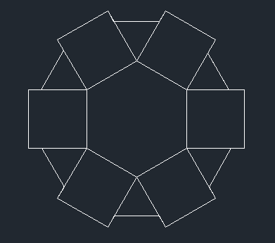
2-D Footprints - 1st level
Explain shapes used
Total width (tip to tip) of your section
Number of floors in your section

Slide 5
2-D Footprints - 1st level
Shapes used: Hexagon, Square, Triangle
Total width: 150 feet
Number of floors in section: 20 floors
150 feet

Slide 6
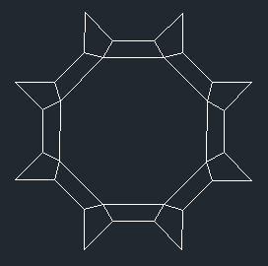
2-D Footprints – 2nd level
Explain shapes used
Total width (tip to tip) of your section
Number of floors in your section

Slide 7
2-D Footprints – 3rd level
Explain shapes used
Total width (tip to tip) of your section
Number of floors in your section

Slide 8
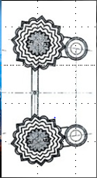
Top View of All Sections

Slide 9
Volume
4th Level
V= 4, 561 ft³
3rd Level
V= 98, 268 ft³
2nd Level
V= 17, 097 ft³
1st Level
V= 439, 930 ft³
Total Volume = 559, 865 ft³

Slide 10
Surface Area
4th Level
T.S.A = 17, 006, 508 ft²
3rd Level
T.S.A = UNKNOWN ft²
2nd Level
T.S.A = 50, 544 ft²
1st Level
T.S.A = 25, 820 ft²
Total Surface Area of whole building =
NOT KNOWN ft²

Slide 11
Construction Cost
1st level area 459,000 m² Cost per m²
2nd level area 136,424.52 m² $4,846.95
3rd level area 62,280 m²
+ 4th level area 19,780 m² 677,485.24 Total Area
Total Area 677,485.24 m² x 4,846.95 Cost Per m²
$3,283,737,084.02 Total Cost
MUST SHOW CORRECT UNITS!

Slide 12
Solution
Explain how your building answers the questions from your Problem Statement, including the focus/strand and location building.

